Slide 1
Final Year Project
GROUP 1
Session 2023-24
Pawandeep Singh (57194)
Ayush Pratap Singh (56068)
Ansh Kumar (56094)
Shivanshu Rawat (56930)

Slide 2
Content
Project 1 – Sign Language To Audio Pipeline
Problem Statement
Solution Overview
Requirements
Design
Implementation
Performance
Project 2 – Smart CCTV
Problem Statement
Solution with Design
Project 3 – Fall Detection
Problem Statement
Solution with Design

Slide 3
Project 1 (Sign Language to Audio Pipeline)

Slide 4

Problem Statement
Mute People use Sign Language
Most Non-Mute people do not understand it properly
This causes problem in smooth conversation
Image source

Slide 5
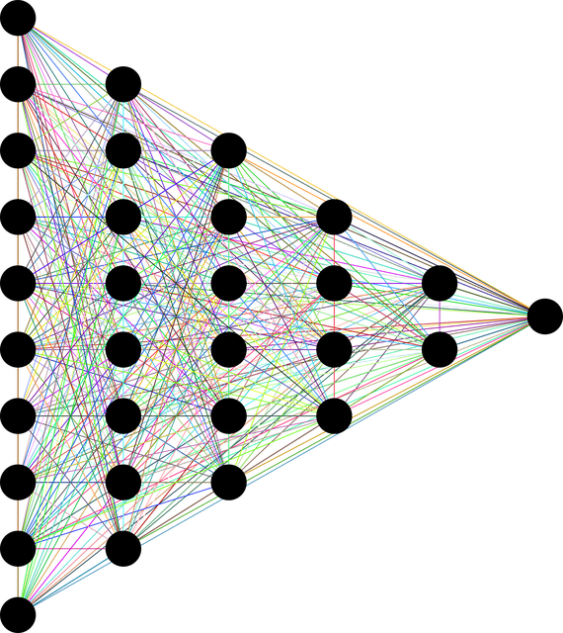
Solution Overview
LSTM based Neural Network model
Model understand Sign Language
Converts Sign language to Text
Text To Audio using TTS module
Image source

Slide 6





Requirements
Software Requirements
Python : For Developing Solution
Packages/ Libs:
Mediapipe : For Hand-Keypoint/ Landmark detection
Keras : For Compiling LSTM based Neural Network
OpenCV : For Image Processing.
Numpy : For performing ARRAY operations
Hardware Requirements:
CPU: Intel core i3 or greater / Apple silicon chip >=M1
Memory : >= 8GB
Camera
image source – official website

Slide 7
Design
FRAMES
LSTM + Fully Connected NN
Hand Landmark Extraction
TTS pipeline
Sign in Text Form

Slide 8
Implementation
For implementing various scripts for Sub Task are created
data-collection.py
training.py
inference.py
Data Collection
Inferring
Training

Slide 9
Data Collection
Config for data-collection
4 samples for each sign
Each sign have recorded for 1sec timeframe
Format shape: [N_samples, Frames, Features]
N_samples: No of samples/ sign samples
Frames: frames/ images for each sign
Features: Feature of each frame = Hand Keypoints
Data stored as NUMPY array.
Later Loaded for training

Slide 10
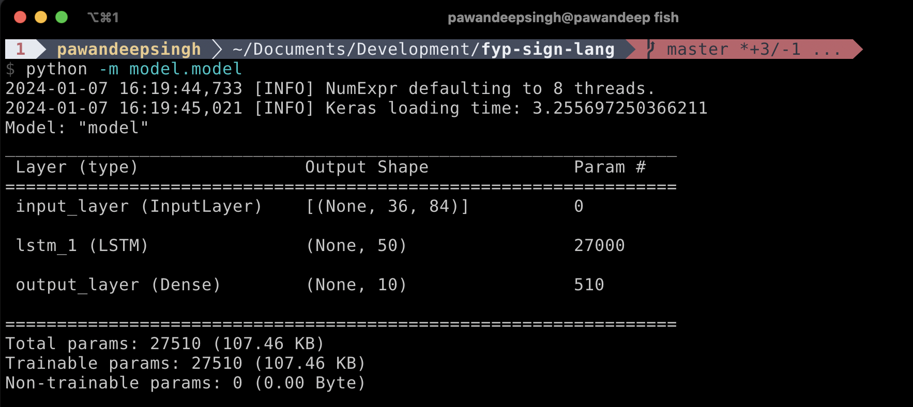
Training
Data loaded which was stored in data preprocessing step
LSTM based Model compiled via KERAS api
Train function called on model
Last epoch model saved
image: model summary

Slide 11
Inference
Also called Prediction part
Model loaded saved previously
Video Capture starts
Frame Preprocessing done
Prediction called
Text to Speech module called

Slide 12
Performance
Whole Model is compiled and Tested on following configs:
OS: Linux Mint, Ubuntu, Mac OS, Windows
RAM: 8GB
CPU: Intel Core i5, Apple M1
Performance
Running at: 17fps
Accuracy : 95%

Slide 13
Project 2 (Smart CCTV)

Slide 14


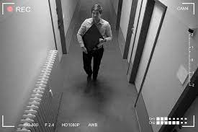
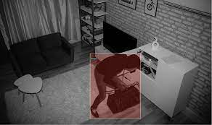
Problem Statement
Conventional CCTV cameras just records
Limited or completely lacks Object Recognition
No Intelligent Alerts for Suspicious Activities
Requires constant monitoring
Limited Analytical Insights
Conventional CCTV
Smart CCTV

Slide 15
Solution
Smart CCTV - Enhancing Surveillance with Computer Vision
Python-based initiative leveraging the power of computer vision
Utilizes the OpenCV library
Several innovative features aimed at improving security and surveillance capabilities

Slide 16
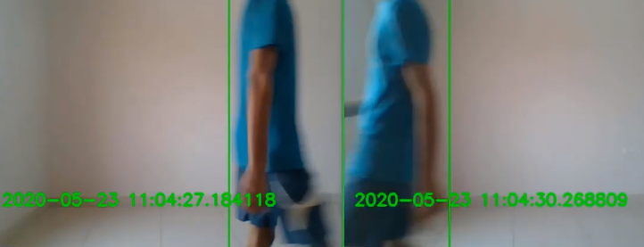
Key Features
Monitor: Detects items that are stolen from the original frame.
Identify: Face identification feature for recognizing individuals.
Rectangle: Detects movement in specific areas of the frame, providing targeted surveillance.
Noise: Monitors and detects movement in a room, generating alerts for potential disturbances.
In-Out: Tracks the number of individuals entering and leaving a room.
Record: Standard recording functionality for continuous surveillance.

Slide 17
Implementation
Start
Load user interface (Tkinter)
Software Details
OpenCV package of Python
User Interface - Tkinter package in Python
SMTP Library (for email alerts)
Start video capture (OpenCV)
Continuous loop
Capture Frame
Monitor
Identify
Rectangle
Detect noise
Generate Alerts
Terminate when user exits

Slide 18
Project 3 (Fall Detection Android App)

Slide 19

Problem Statement
Phone can fall accidently at unknown location
There is no easy way to track them back
Even phone can witness some accident
There is no easy way to detect it

Slide 20
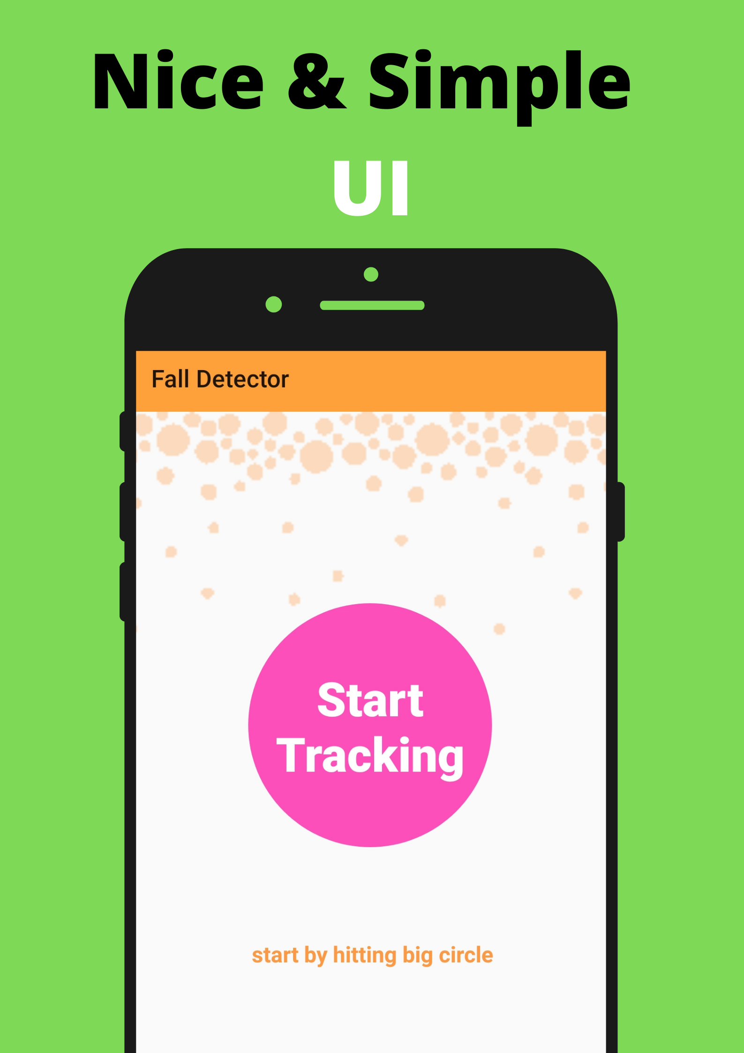
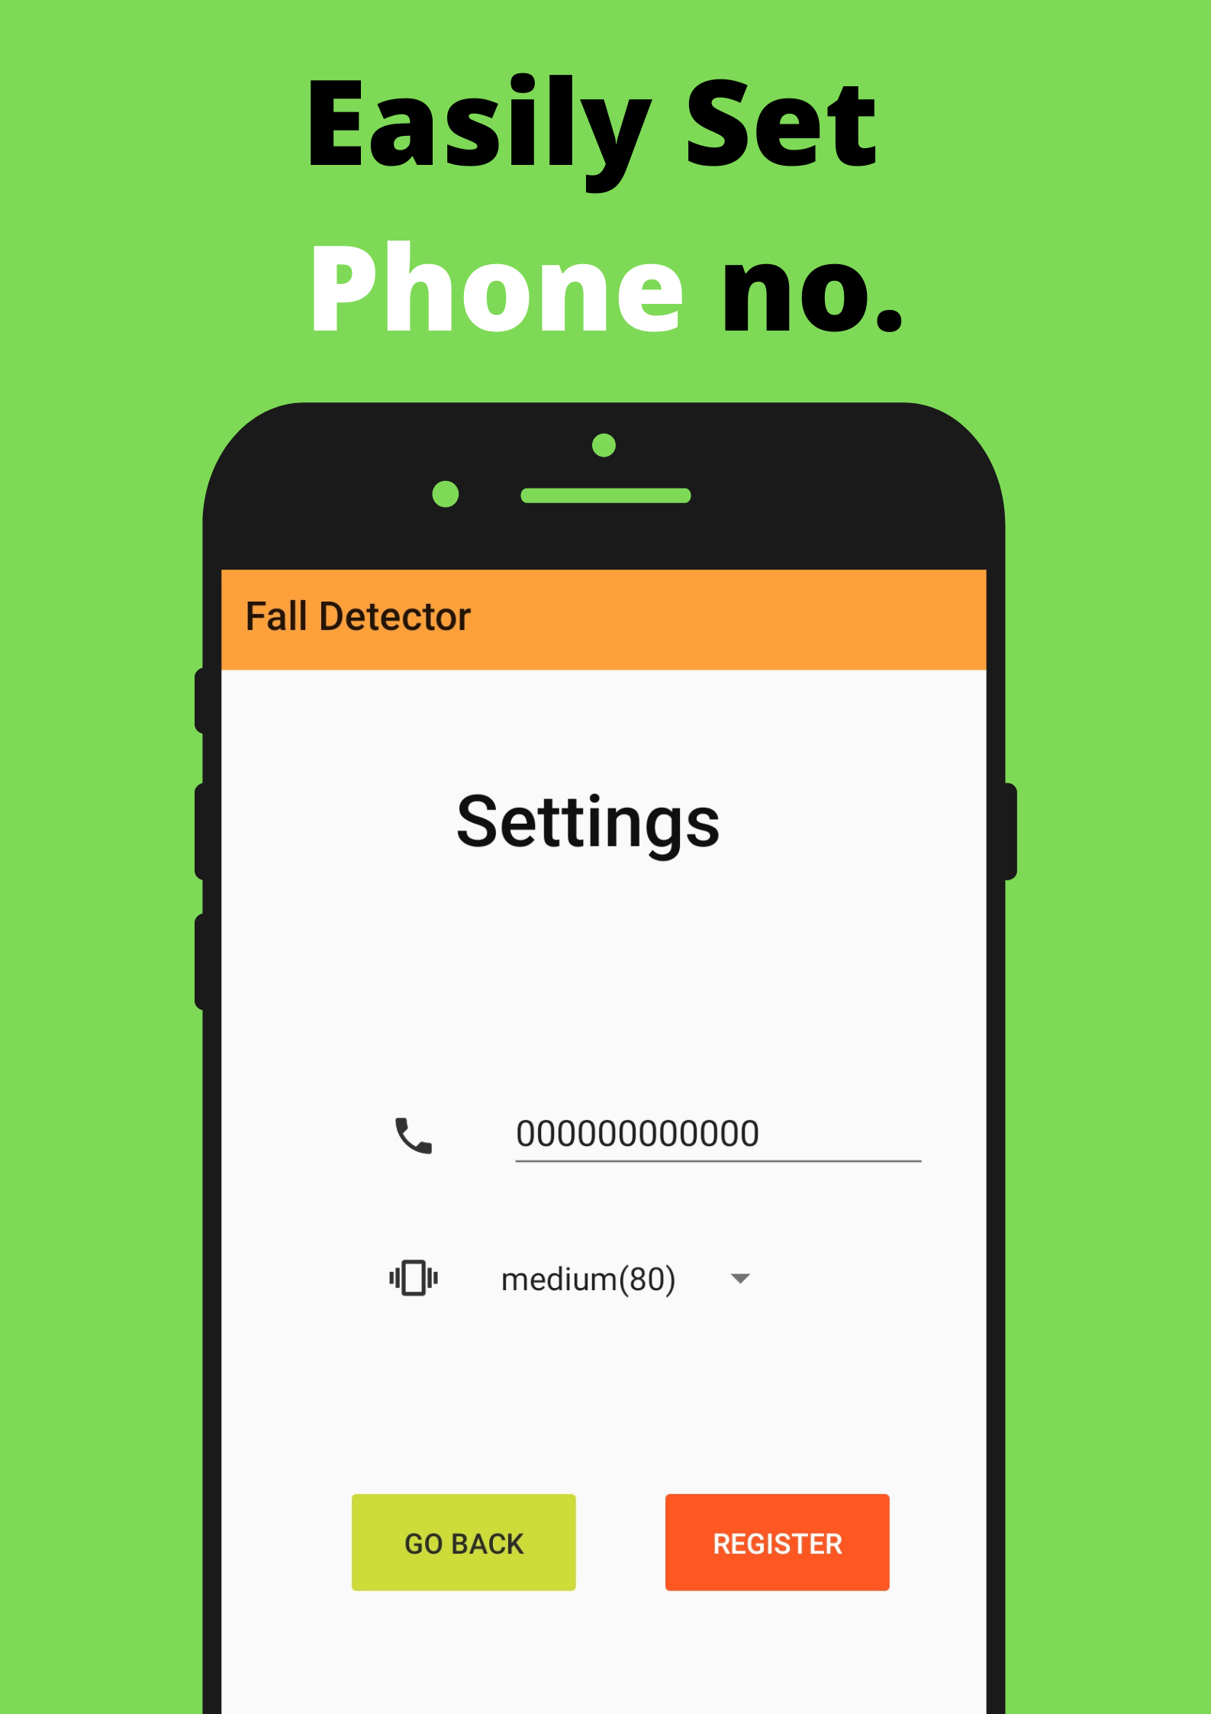
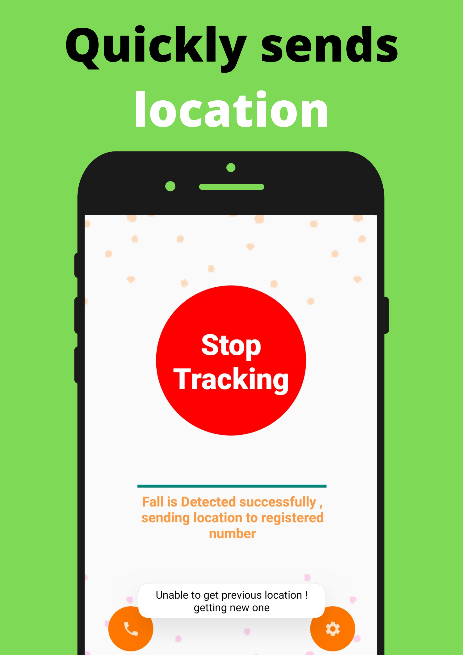
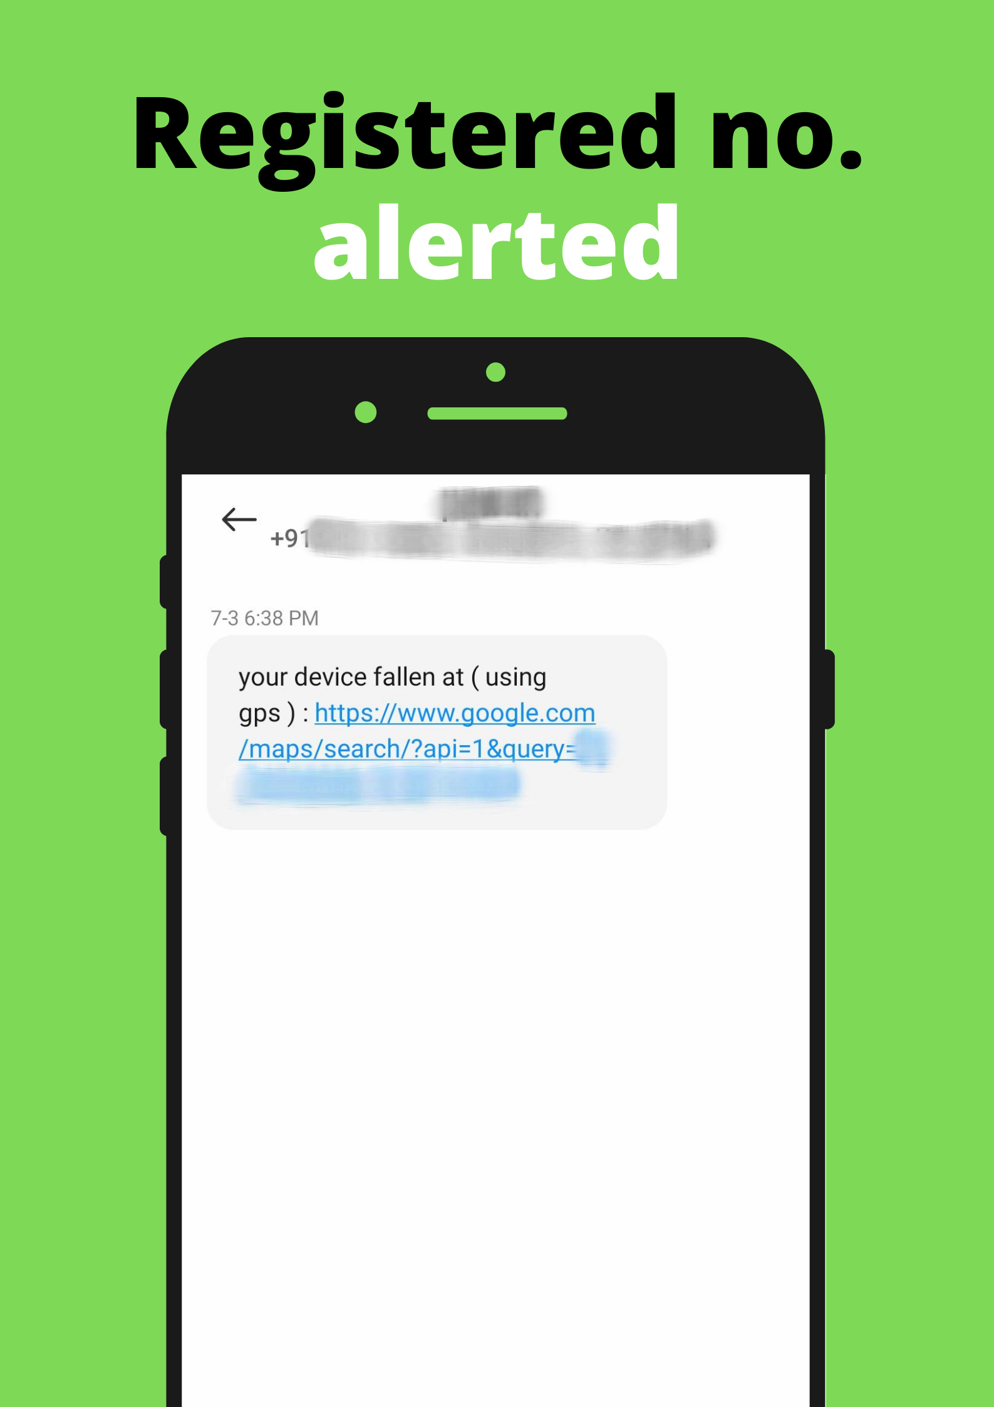
Solution
A mobile app can be developed
To detect Fall
To detect accident

Slide 21
Implementation
Mobile App Tracking
Accelerometer sensor
Software details
Android Studio
Kotlin Language
Packages/ Classes:
Sensor Manager : listening accelerometer
Location Manager : Getting current location
SMS Manager : Sending SMS alert
Sensor values
Accumulation
Sum past 50 Value
>= THRESH
Send Alert

